Slide 1
MyGaDOE Portal Provisioning for Security Officers
Presented by
Chris Rivera
GaDOE Helpdesk Manager

Slide 2
MyGaDOE Portal Provisioning Basics
Based on User Self-Provisioning
Organization Security Officer Approvals
Application Security Officer Approvals

Slide 3
User Self Provisioning
Request a New Account
Add or Remove Organizational Roles
Add or Remove Application Roles
Change/Update Account Information
Change Passphrase

Slide 4
Organization Security Officer
Review/Approve requests for user access under assigned organization.
Add new users under assigned organization.
Modify account status (Suspend, Un-Suspend, Terminate) under assigned organization.
Reset passphrases for users under assigned organization.

Slide 5
Application Security Officer Approvals
Review/Approve requests for user access to their assigned application regardless of user’s assigned organization

Slide 6
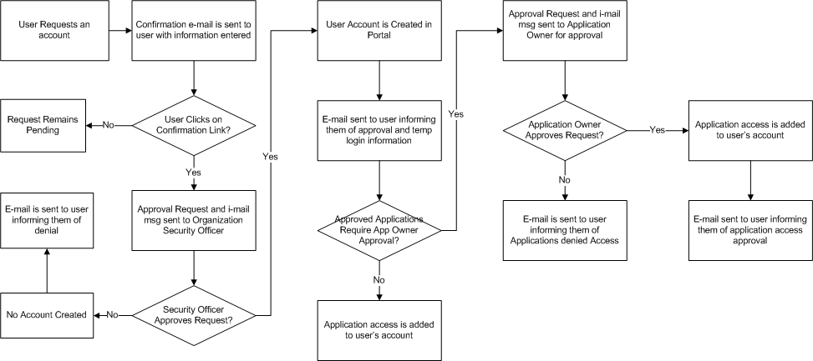
Provisioning Workflow

Slide 7
Signing Up for a Portal Account
New User Registration Wizard
Step 1 – Enter User Information
Step 2 – Select Districts And Roles
Step 3 – Select Applications And Roles
Step 4 – Request Submission Summary

Slide 8
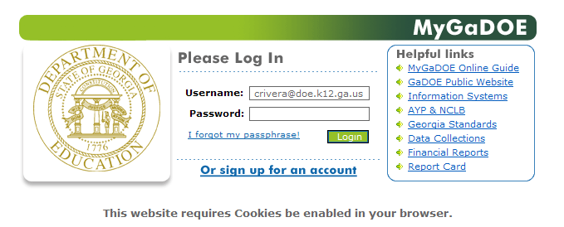

Slide 9
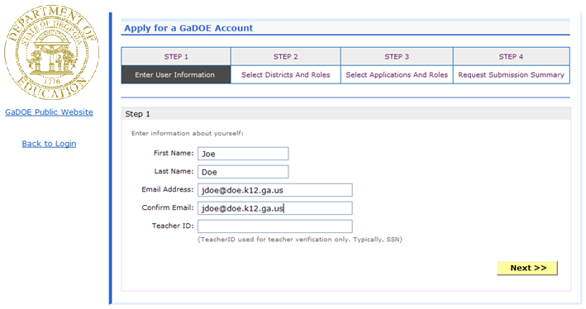
Enter Name and e-mail Address.
E-mail address is also Portal Login ID.
Teacher ID allows for automatic account creation should information match from previous CPI collection.

Slide 10
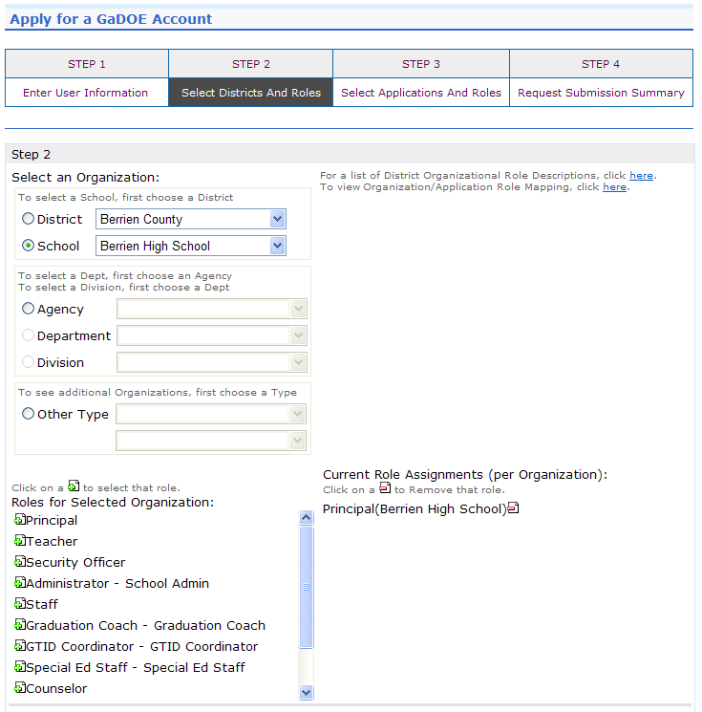
Select appropriate Organization: District, DOE Agency, or Other. Available Organizations appear in appropriate drop down boxes.
Next select appropriate Organization Role from provided list. List is dependent on Organization selected.
To add a role assignment click on green “+” sign to the left of role.

Slide 11
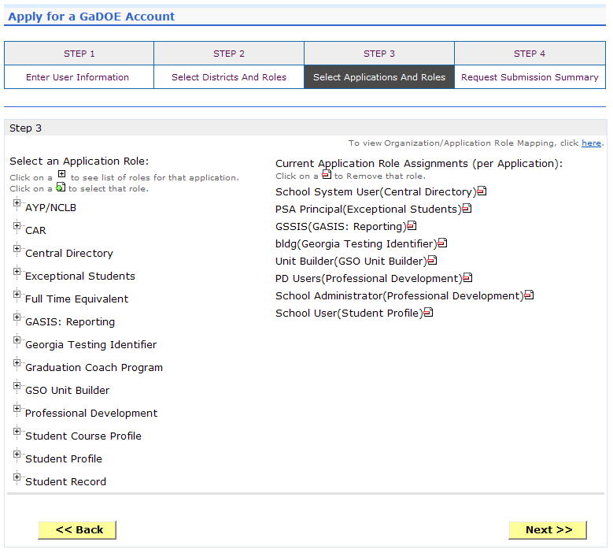
Based on Organizational role selected, a default set of application roles will automatically be added to profile.

Slide 12
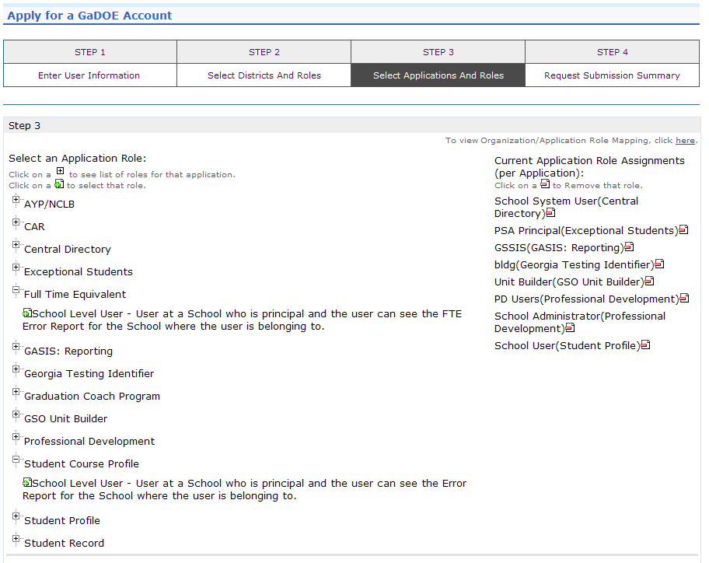
To add additional application roles, click on “+” sign next to application and then the green “+” sign beside the appropriate role.
To remove application roles from list of those assigned, click on red “-” beside the role.

Slide 13
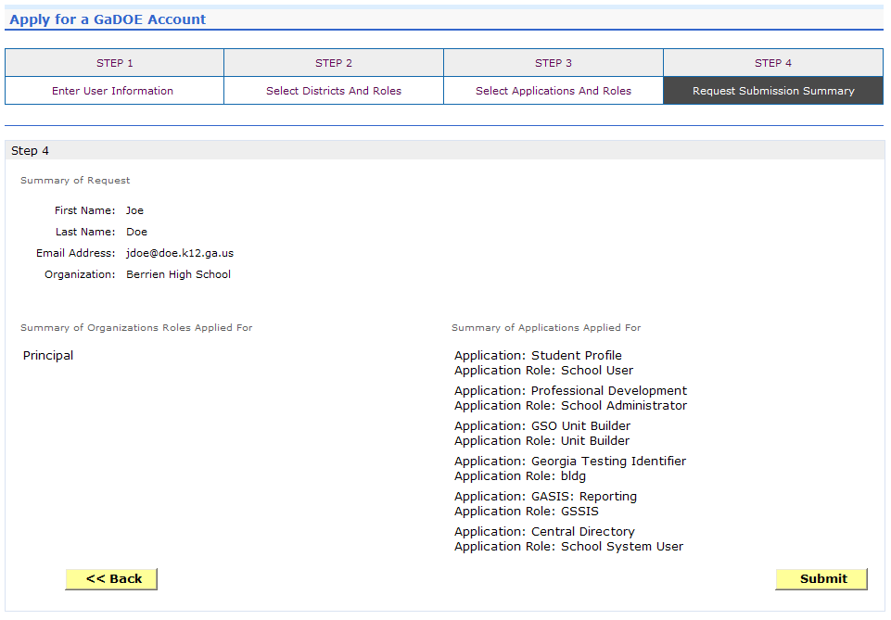
Review all the information entered into account setup wizard.
If all is as required, click on the “Submit” button to submit request for approval.
Click to Submit Request

Slide 14
Request Submittal Confirmation

Slide 15
User Certification E-mail
User must click here

Slide 16
Modifying Existing Portal Account
Add or Remove Organizational Roles and/or Application Roles
Change/Update Account Information
Change Passphrase

Slide 17
Log into MyGaDOE Portal – Portal Home Page
Click to Access Profile Screen

Slide 18
Add or Remove Organizational Roles and/or Application Roles
Step 1 – User Information
Step 2 – Select District and Roles
Step 3 – Select Applications and Roles
Step 4 – Request Submission Summary

Slide 19
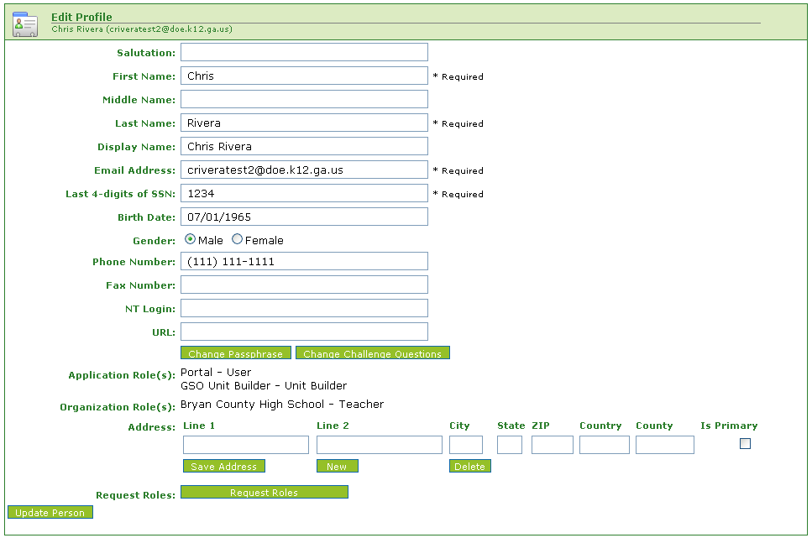
Profile Screen – Request Roles
Click Here

Slide 20
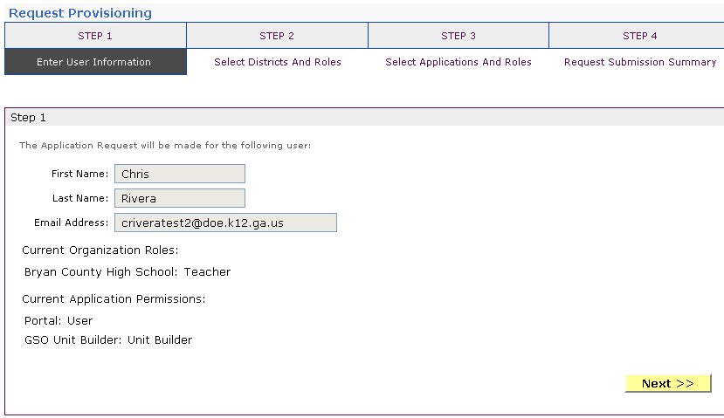
Review account information and current Org and Application role provisioning in first step of Request Provisioning Wizard

Slide 21
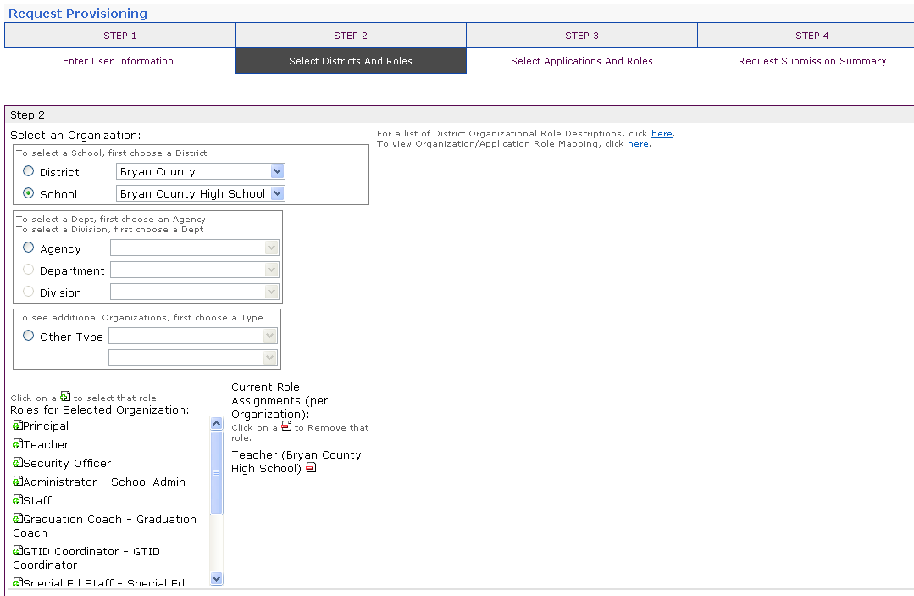
To add additional application roles, click on “+” sign next to application and then the green “+” sign beside the appropriate role.
To remove application roles from list of those assigned, click on red “-” beside the role.

Slide 22
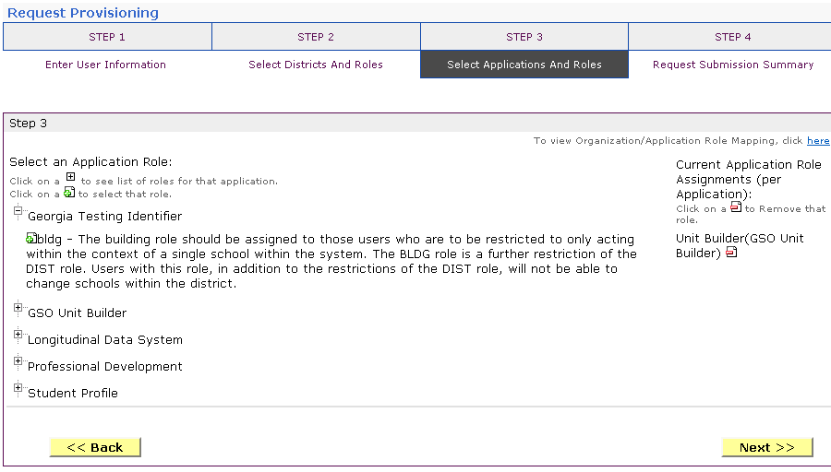
To add additional application roles, click on “+” sign next to application and then the green “+” sign beside the appropriate role.
To remove application roles from list of those assigned, click on red “-” beside the role.

Slide 23
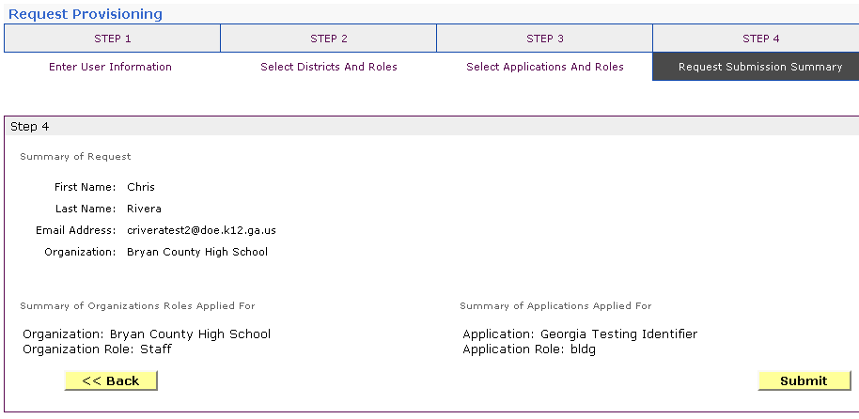
Review all the information entered into account setup wizard.
If all is as required, click on the “Submit” button to submit request for approval.
Click to Submit Request

Slide 24
Request Submittal Confirmation

Slide 25
Change/Update Account Information
Name information
Login/e-mail information
Phone Number
Address Information
Challenge Questions and Answers

Slide 26
Correct/Update Profile Information
On the User Profile screen, information can be added or modified as desired.
Even e-mail address (login) can be modified.
Once appropriate changes have been made to profile, click on “Update Person” to save changes.
Click to Save Changes

Slide 27
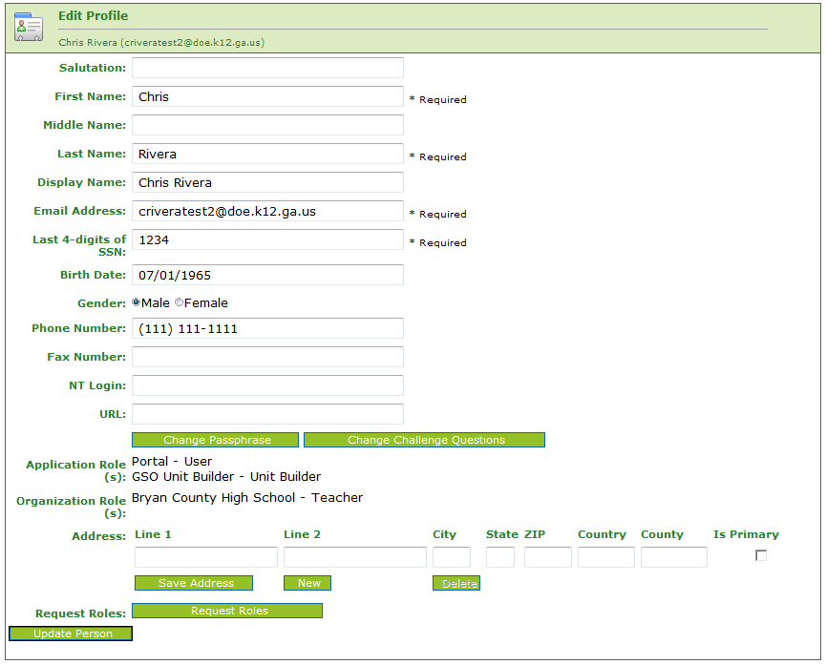
Change Challenge Questions and/or Answers
To review and/or modify challenge questions and answers, a user can click on “Change Challenge Questions” button
Click Here

Slide 28
Correct/Update Challenge Questions and Answers

Slide 29
Profile Screen – Change Passphrase
A user may reset their passphrase by clicking on the “Change Passphrase” button.
Click Here

Slide 30
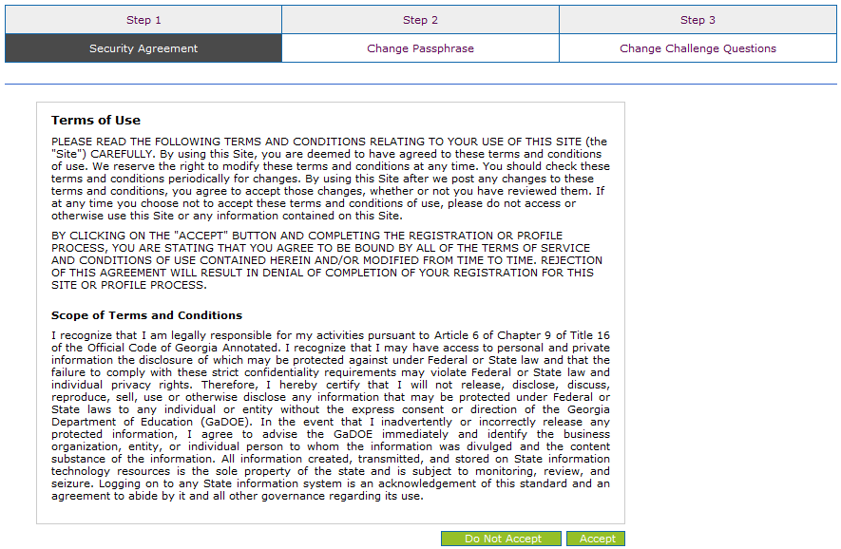
Terms of Use Agreement – User Must Accept
Click Here to Accept

Slide 31
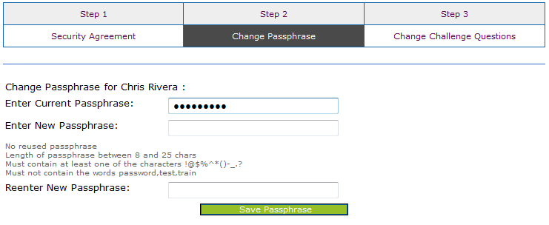
1. Enter Current Passphrase 2. Enter New Passphrase 3. Re-enter New Passphrase

Slide 32
Security Officer Responsibilities
Review/Approve requests for user access under assigned organization.
Add new users under assigned organization.
Modify account status (Suspend, Un-Suspend, Terminate) under assigned organization.
Reset passphrases for users under assigned organization.

Slide 33
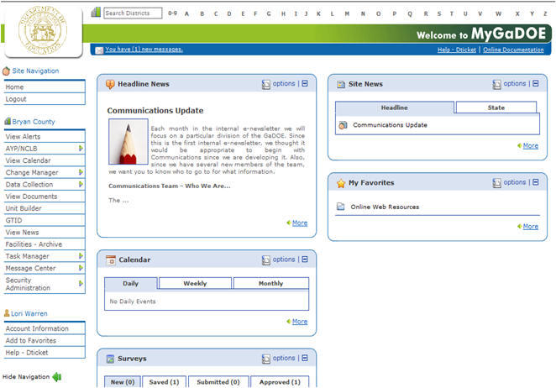
Review Access Requests – Approve/Deny
Portal access requests are delivered via the MyGaDOE Portal i-Mail system.
Security Officers can view the request information and then take appropriate action.
Portal i-mail is access from Portal Home page message link at top of page.
Click to Access i-Mail

Slide 34
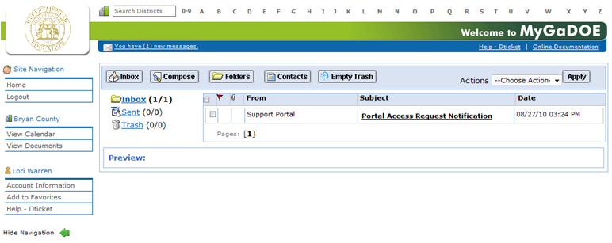
I-Mail Message Inbox
New and existing i-Mail messages are show in Inbox. New messages appear in “Bold”. To view a message Click on message and information will appear in Preview box below.

Slide 35
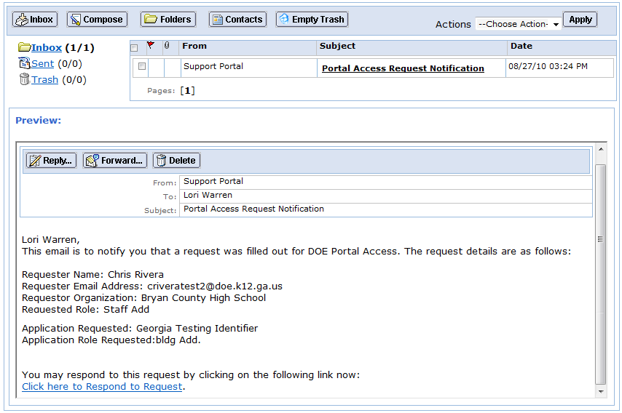
I-Mail Message Preview
Information from request can be viewed.
Request will show who requested, e-mail address of user, requested Organization roles and any requested Application Roles.
To take action, click on the link at bottom of message.
Click Here

Slide 36
Request Approvals Screen
New and Pending requests can be viewed on this screen. Requests requiring action have a green arrow beside them. To view entire request click on “+” sign beside the request.

Slide 37
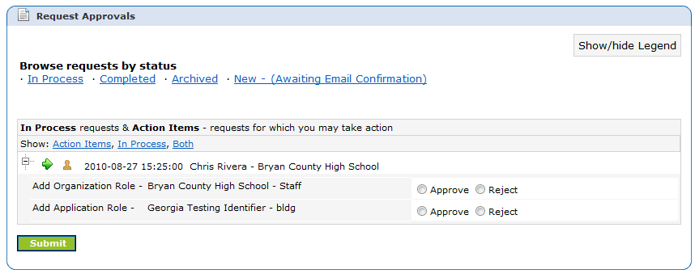
Request Approvals Screen
Security Officer will approve or reject each line item and then submit. Once complete, account will be created (New Account) and/or additional roles will be added to user account.

Slide 38
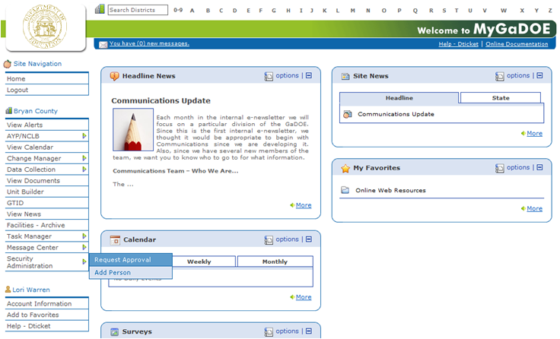
Request Approvals Screen
The Request Approval screen can also be accessed through the Security Administration menu available for Security Officers.
The menu item, “Request Approval” is located on the left hand navigation menu.
Click to Access

Slide 39
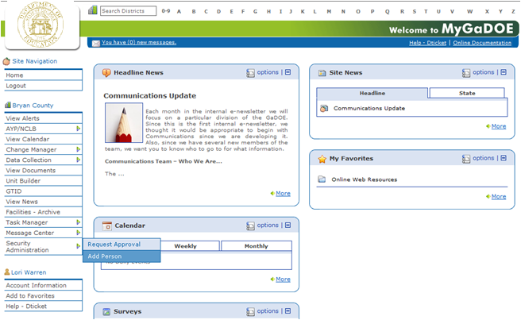
Adding New Users
Organization Security Officers have the ability to add new users to the portal which do not have a Portal Account.
This option is available under the Security Administration application link on the left hand navigation menu using the “Add Person” Link.
Click to Access

Slide 40
Security Officer - Adding New User
Add User Registration Wizard
Step 1 – Enter User Information
Step 2 – Select Districts And Roles
Step 3 – Select Applications And Roles
Step 4 – Request Submission Summary

Slide 41
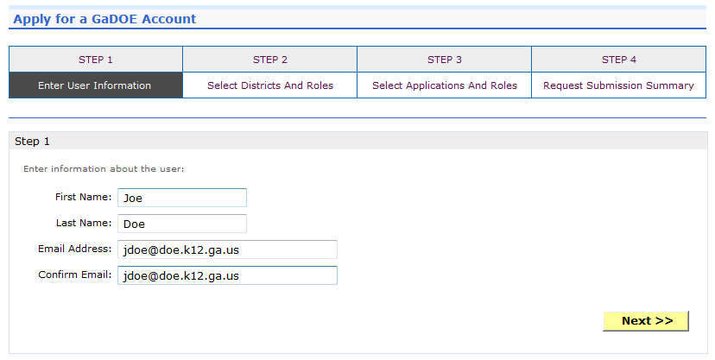
Add Person – Step 1, User Information
Enter Name and e-mail Address.
E-mail address is also Portal Login ID.
Teacher ID allows for automatic account creation should information match from previous CPI collection.

Slide 42
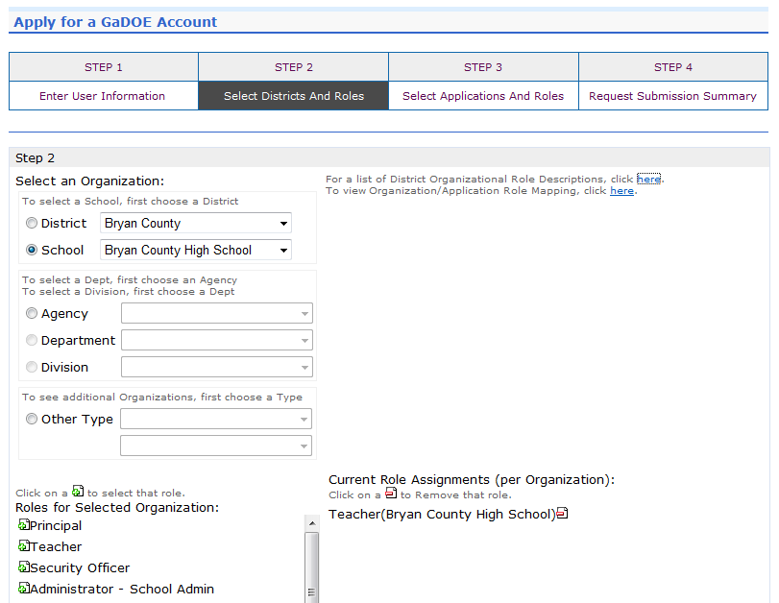
Add Person – Step 2, Districts And Roles
Select appropriate Organization: District, DOE Agency, or Other. Available Organizations appear in appropriate drop down boxes.
Next select appropriate Organization Role from provided list. List is dependent on Organization selected.
To add a role assignment click on green “+” sign to the left of role.

Slide 43
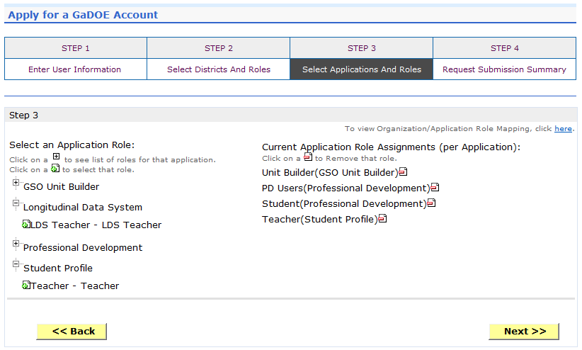
Add Person – Step 3, Applications And Roles
Based on Organizational role selected, a default set of application roles will automatically be added to profile.

Slide 44
To add additional application roles, click on “+” sign next to application and then the green “+” sign beside the appropriate role.
To remove application roles from list of those assigned, click on red “-” beside the role.

Slide 45
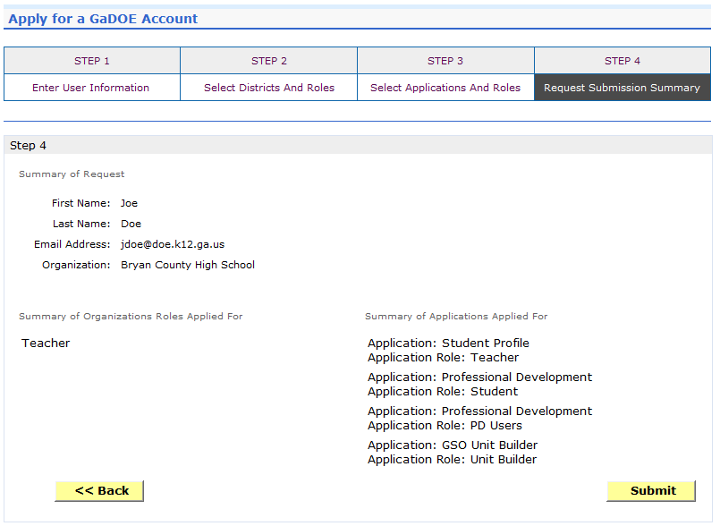
Add Person – Step 4, Submission Summary
Review all the information entered into account setup wizard.
If all is as required, click on the “Submit” button to submit request for approval.
Click to Complete

Slide 46
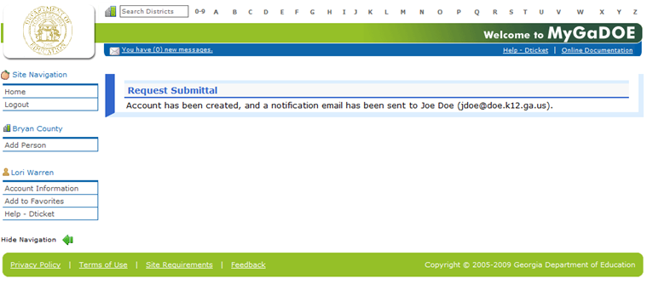
Add Person – Request Submitted Account has been created and user has been sent an e-mail with temporary login information.

Slide 47
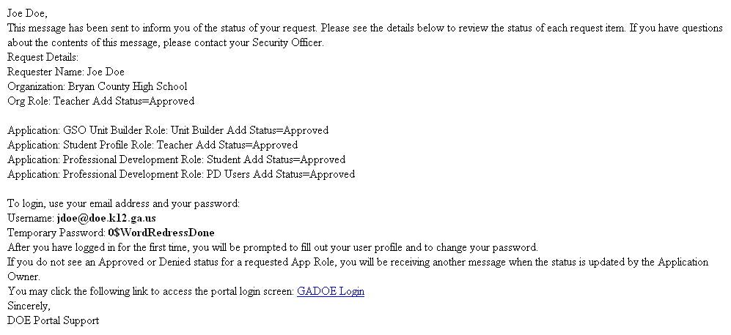
Notification e-Mail to User User receives an e-mail notifying them their account has been created with temporary login information.

Slide 48
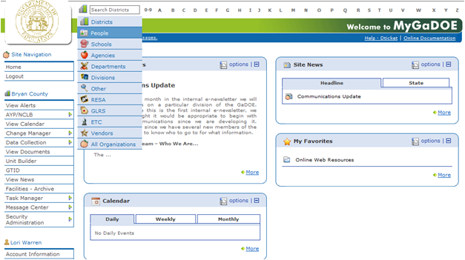
Modify Account Status (Suspend, Un-Suspend, Terminate)
By performing a People Search in the portal and editing a user’s account, within your assigned organizations, a Security Officer has the ability to Suspend, Un-Suspend, or Terminate a user’s account in the system.

Slide 49
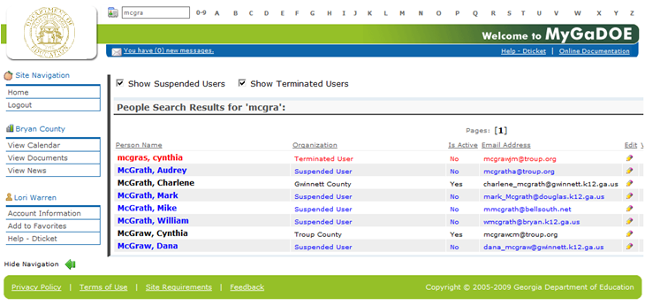
People Search Results By selecting Show Suspended or Show Terminated users, Security Officers can see all users in system matching criteria.
Click to Edit

Slide 50
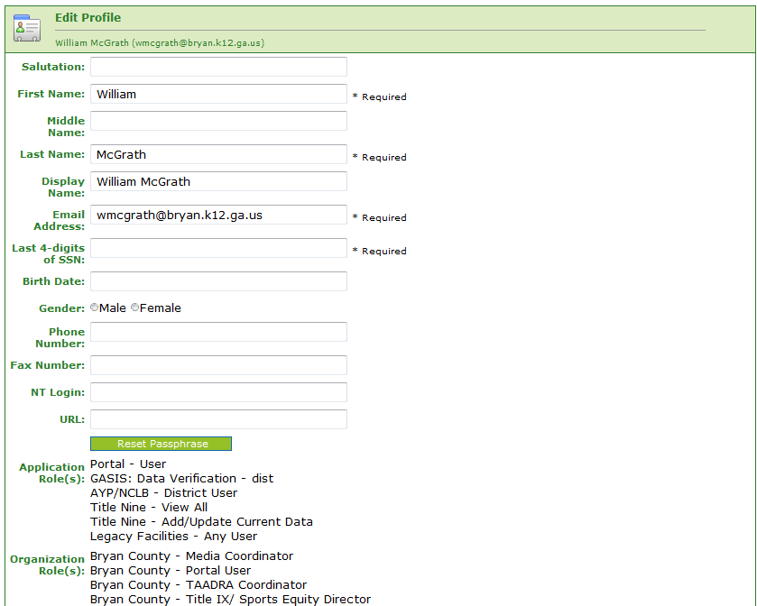
Profile Edit Screen
To modify the Account Status for a user, scroll down to bottom of the Profile Edit screen for selected user.

Slide 51
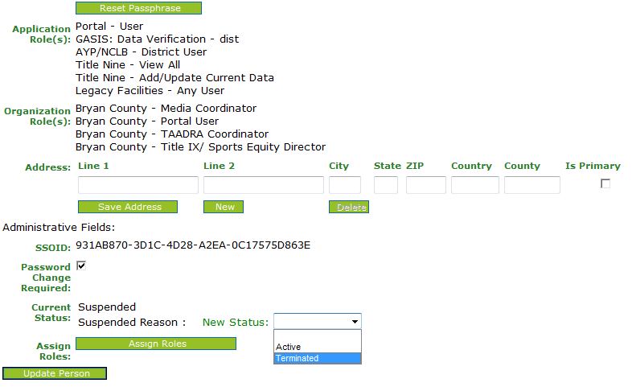
Modify Status – Select Desired Status
Once the desired user status is selected, click on the “Update Person” to effect changes to user’s account.
Important: Terminated users cannot be re-activated by Security Officers, call Helpdesk for Assistance in re-activating terminated accounts.
Select Desired Status

Slide 52
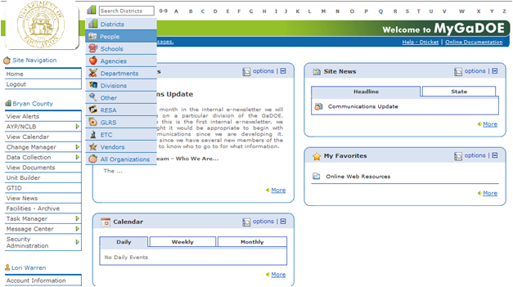
Reset User Passphrase
By performing a People Search in the portal and editing a user’s account, within your assigned organizations, a Security Officer has the ability reset a user’s passphrase.

Slide 53
People Search Results By selecting Show Suspended or Show Terminated users, Security Officers can see all users in system matching criteria.
Click to Edit

Slide 54
Profile Edit Screen
To reset Passphrase for selected user, click on the Reset Passphrase button on the Profile Edit Screen for selected user.
Click Here

Slide 55
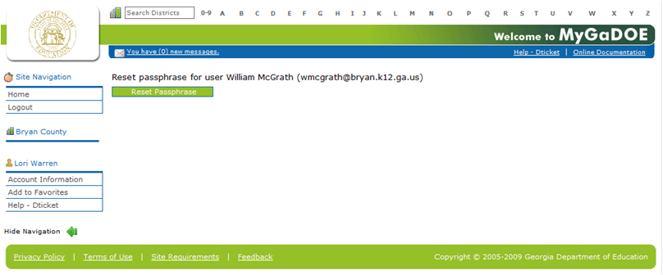
Reset Passphrase Verify user information and click on the Reset Passphrase button again.

Slide 56
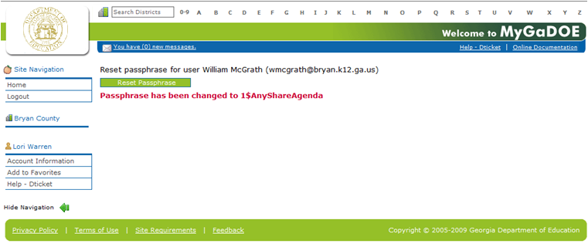
Reset Passphrase A new Passphrase is generated and displayed on the screen. Provide new passphrase to user, they will not receive via e-mail.

Slide 57
Provision Matrix – Security Officer Guide to User Provisioning
Provides listing of available application roles for each application within the MyGaDOE Portal.
Provides listing of default application roles provided for each organization role within the MyGaDOE Portal.

Slide 58
Provision Matrix – Role Mapping Access
The Provision Matrix can be access through a link on the Request Provisioning wizard, steps 2 & 3.
The link is located near the top, shown here.
Provision Matrix

Slide 59
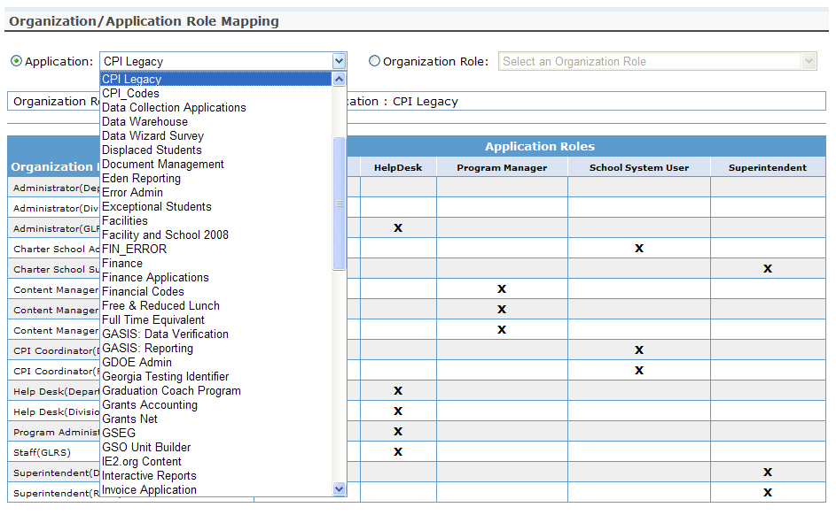
Provision Matrix – Application Mapping
Select the Application from the drop down list on the Provision Matrix for the desired application.
Appropriate Application Roles will be shown for selected application.

Slide 60
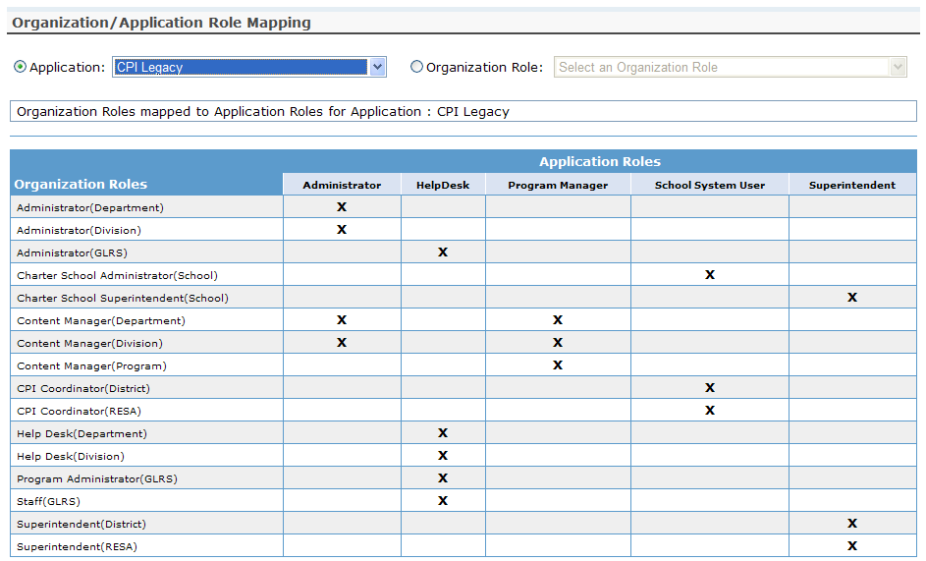
CPI – Role Mapping

Slide 61
Free & Reduced Lunch – Role Mapping

Slide 62
FTE – Role Mapping

Slide 63
Pre Identify for Testing – Role Mapping

Slide 64
Private School Collection – Role Mapping

Slide 65
Student Course Profile – Role Mapping

Slide 66
Student Record – Role Mapping

Slide 67
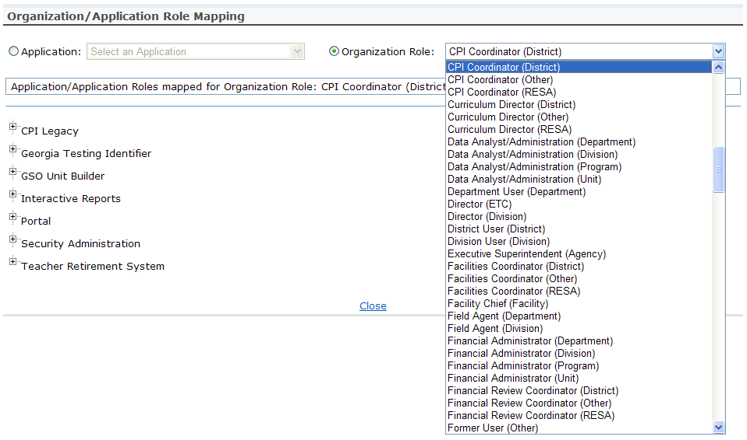
Provision Matrix – Org Role Mapping
Select the Organizational Role from the drop down list on the Provision Matrix for the desired Org Role.
Default set of applications and roles will be listed for selected Org Role.

Slide 68
CPI Coordinator District – App Role Mapping

Slide 69
FTE Coordinator (District) – App Role Mapping

Slide 70
GTID Coordinator (District) – App Role Mapping

Slide 71
Principal (School) – App Role Mapping

Slide 72
Teacher (School) – App Role Mapping

Slide 73
Security Officer (District) – App Role Mapping

Slide 74
Superintendent (District) – App Role Mapping

Slide 75
SR Coordinator (District) – App Role Mapping

Slide 76
Questions?
How to Get Additional Assistance:
You may contact the Technology Management Customer Support Team by using the Help-dticket link on the left side of the MyGaDOE portal menu.
You may also request assistance by emailing dticket@doe.k12.ga.us or by calling 1-800-869-1011. Please provide a detailed message as well as your contact information.
Technology Management Customer Support Center
Georgia Department of Education

